Slide 1
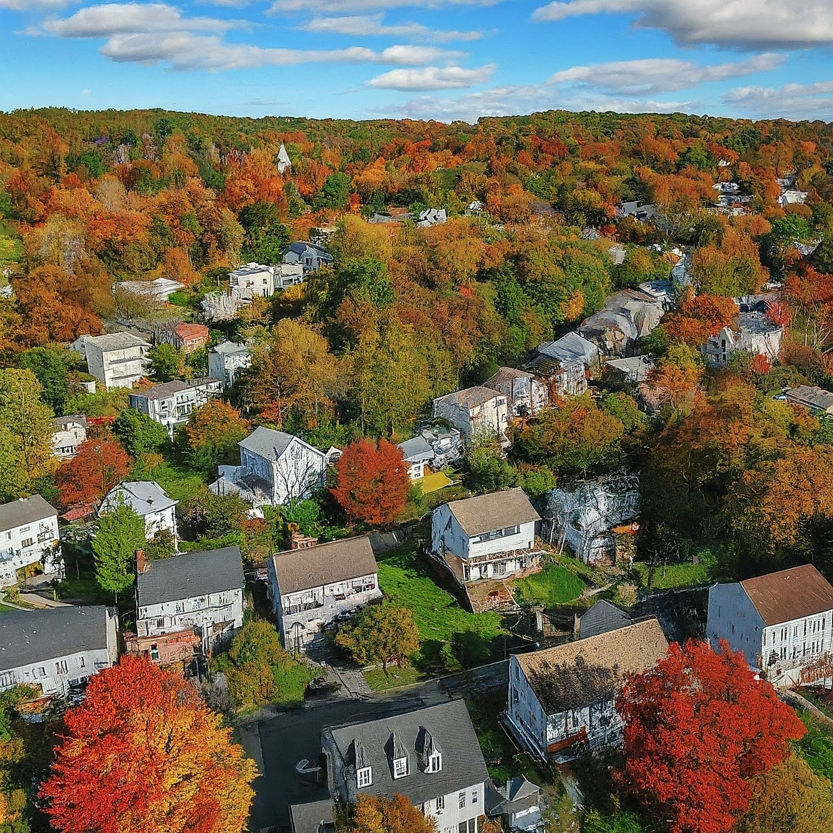
Navigating the Connecticut Real Estate Landscape: A Data-Driven Approach
Project Guided By:
Dr. Sharmin Sultana

Slide 2









DATA SCIENCE PROCESS
Insights
Real World
Collect Data
Process Data
Analyze Data
EDA
Models &
Algorithms
Build Data Product
Communicate , Report , Visualize
Make Decisions

Slide 3


RESEARCH QUESTION

Slide 4
1. How do changes in unemployment rates, interest rates and median income in Connecticut affect the overall sale price and sales volume of different property types over time and what predictive insights can be derived from this analysis?
Temporal Trends
Analyzing changes in sales volume and sale amounts over time.
Geospatial Dynamics
Exploring spatial patterns and variations in sales activity across different regions of Connecticut.
Predictive Analysis
Using historical data to forecast future trends and provide actionable insights for stakeholders in the residential real estate sectors.
Economic Influences
Investigating the impact of economic factors such as unemployment rate, business establishments, employee wages and employee count on real estate sales.

Slide 5
2. How do variations in neighborhood school performance, crime rates & access to healthcare facilities within different Connecticut towns influence the trends in sales volume and price elasticity of residential buildings ?
Amenities Impact
Quantify how vicinity to schools, crime rates (type, severity) & proximity to healthcare facilities impact sale volume & price elasticity across Connecticut
towns
Predictive Analysis Using historical data to forecast future trends & provide actionable insights for stakeholders in the residential real estate sectors.
Temporal Trends Analyzing how amenities affect overall market activity & responsiveness to price changes over period.
Geospatial Dynamics Investigate variations in school performance, crime rates & healthcare access across different Connecticut towns.

Slide 6
THE DIKW MODEL
Wisdom
Knowledge
Information
Data

Slide 7







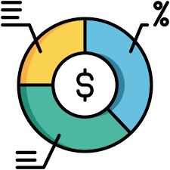


CT REAL ESTATE DATA
CONTENT
Towns
Year
Towns
Resident Type
CATEGORIES
Condo
Single family
Two
family
Three
family
Four
family
Sales Amount
Sales Ratio
Assessed Value
Location
Year

Slide 8





ECONOMIC DATASET
CONTENT
ECONOMIC FACTORS
Towns
Year
CATEGORIES
Unemployment Rates
Employment
Count
Employee
Wages
Business Establishments

Slide 9






SOCIAL DATASET
CONTENT
SCHOOLS
HOSPITALS
CRIMES
CATEGORIES
Towns
Year
No of Healthcare Centers
Crime/100,000
Total no of
Crimes
Count of Schools

Slide 10

DATA ENGINEERING

Slide 11











DATA PIPELINE & ARCHITECTURE
Local Host/Server

Slide 12
THE DIKW MODEL
Wisdom
Knowledge
Information
Data

Slide 13

TEMPORAL ANALYSIS

Slide 14
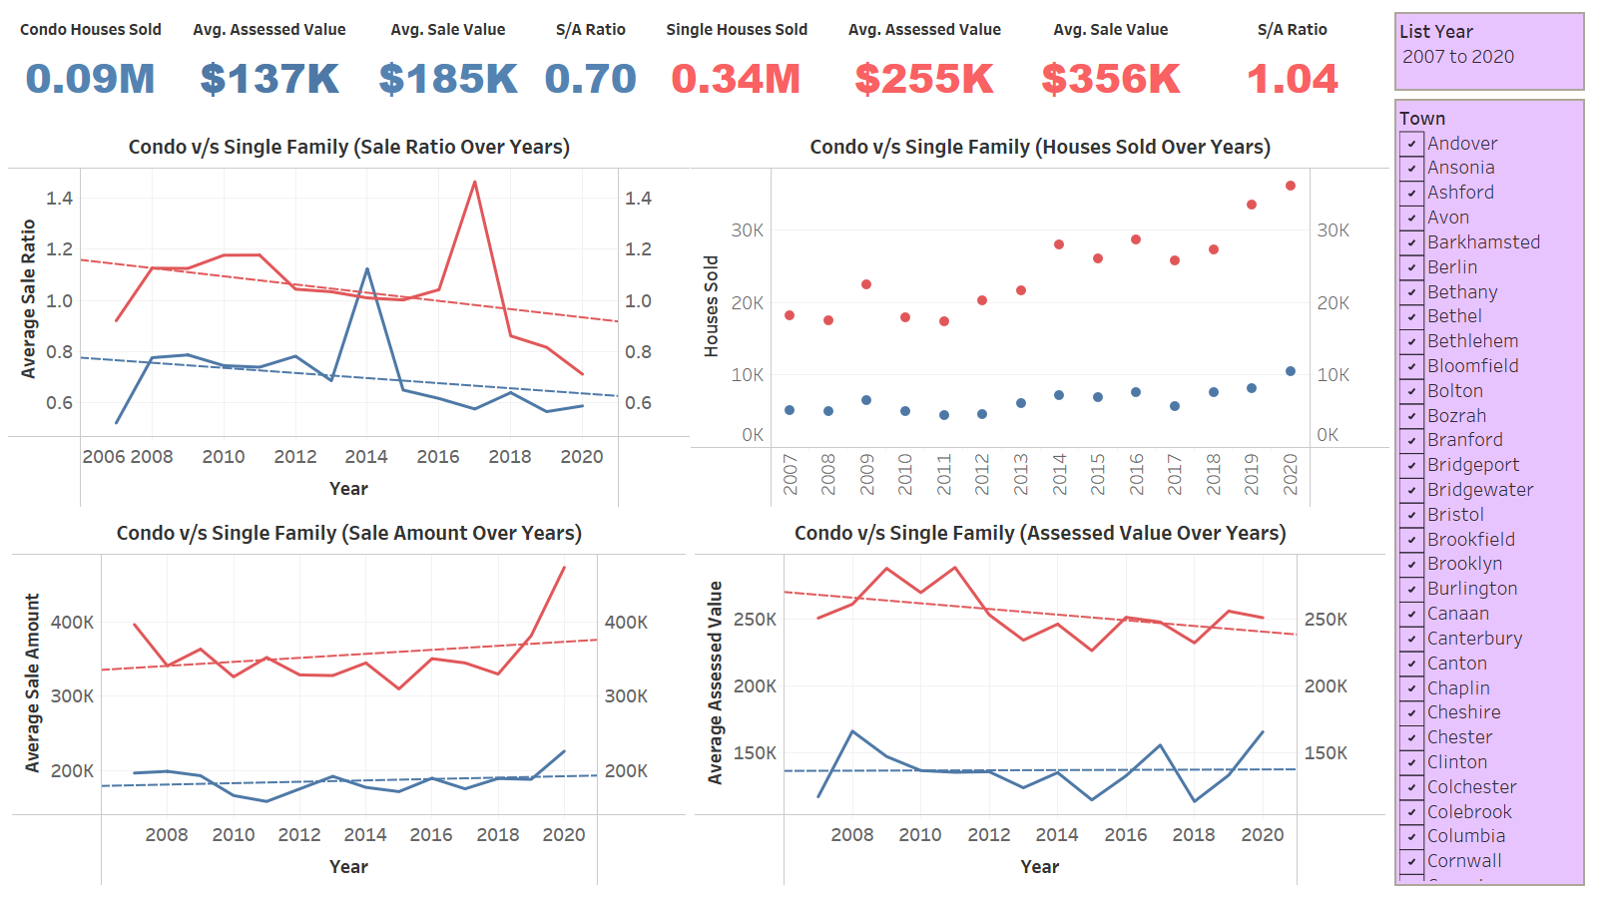

Slide 15
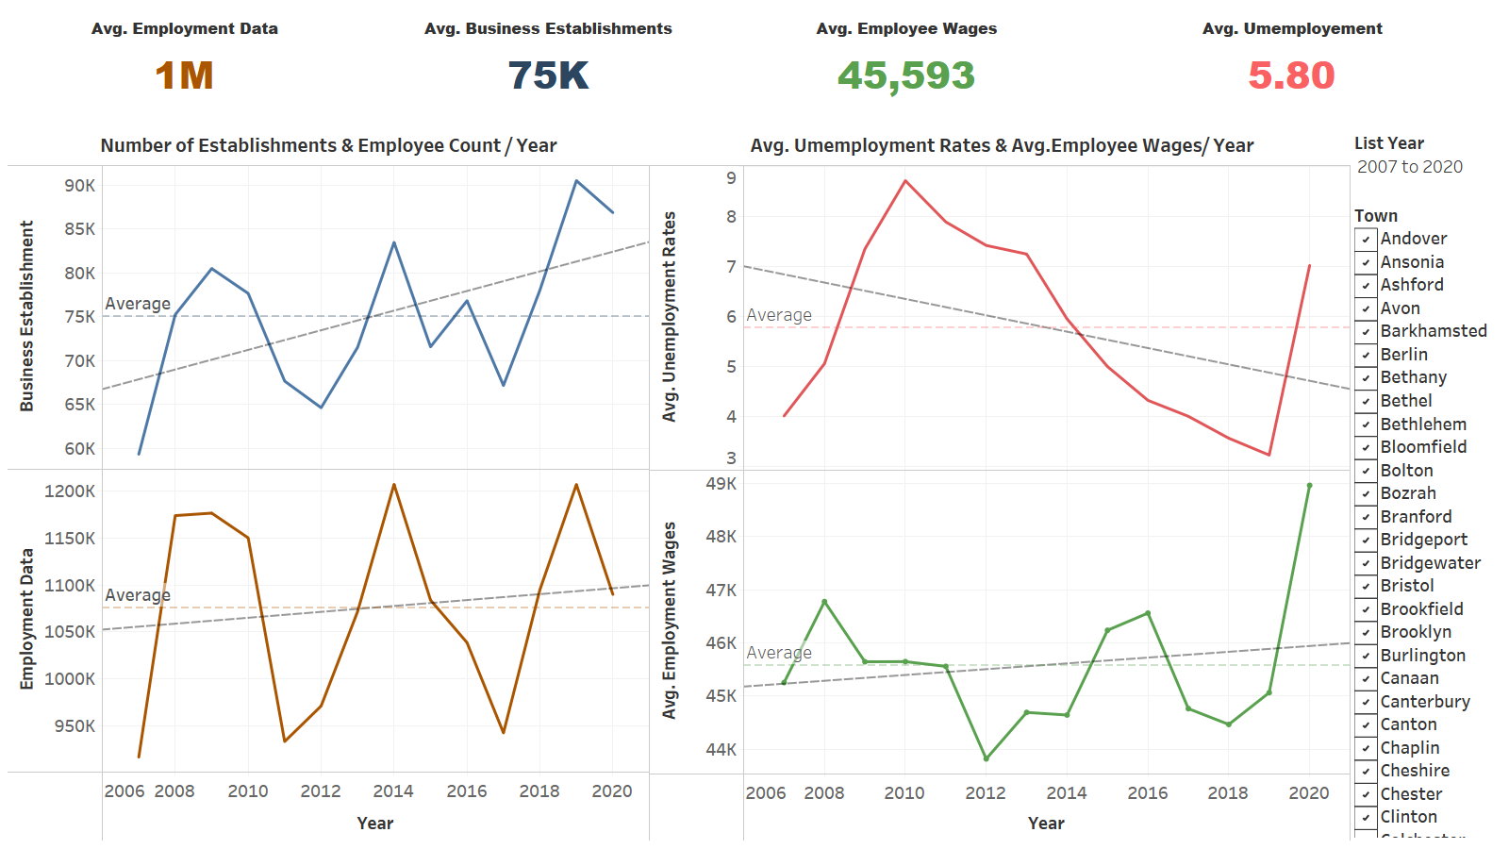

Slide 16
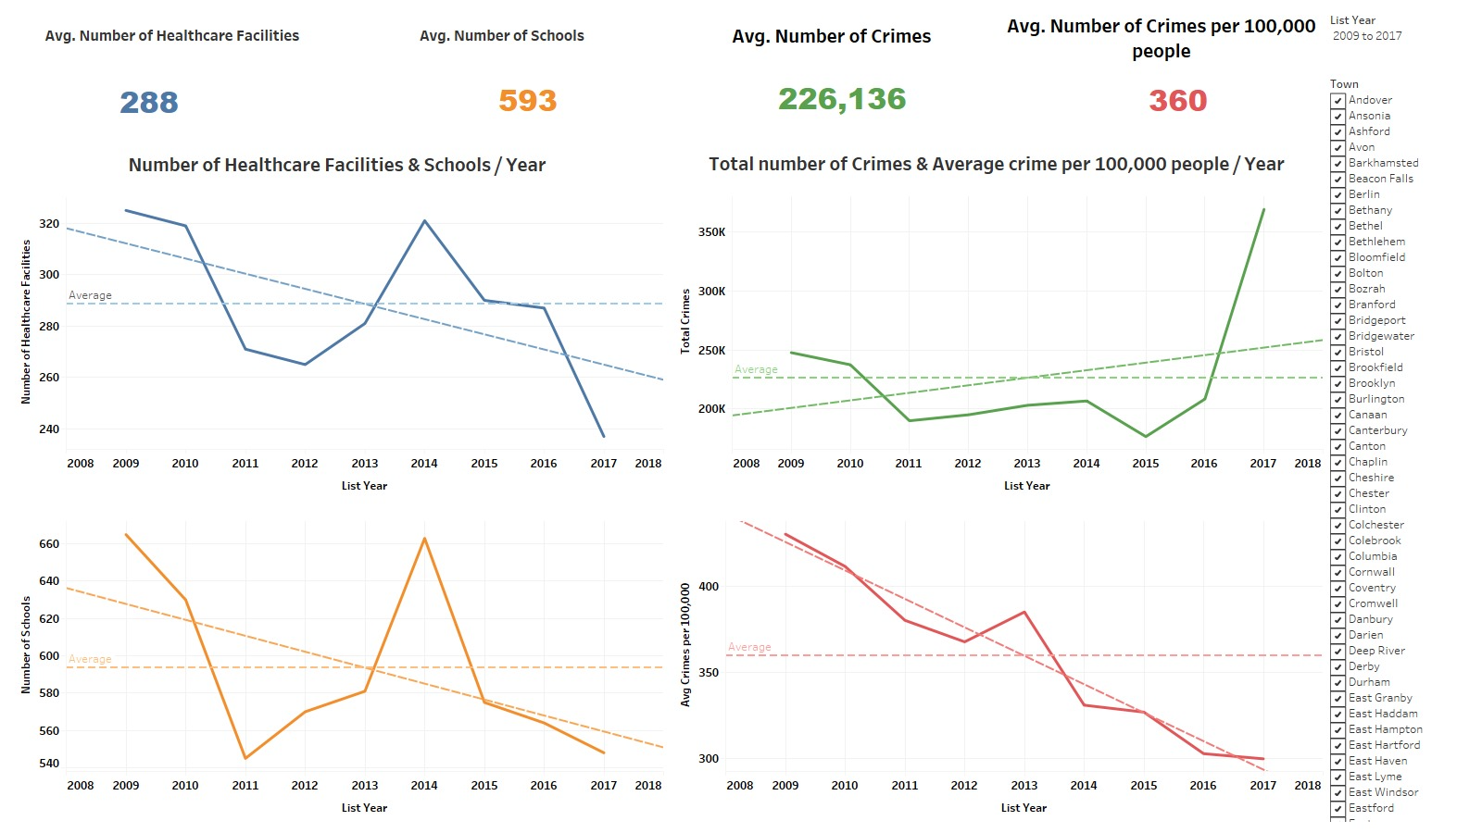

Slide 17

GEOSPATIAL ANALYSIS

Slide 18
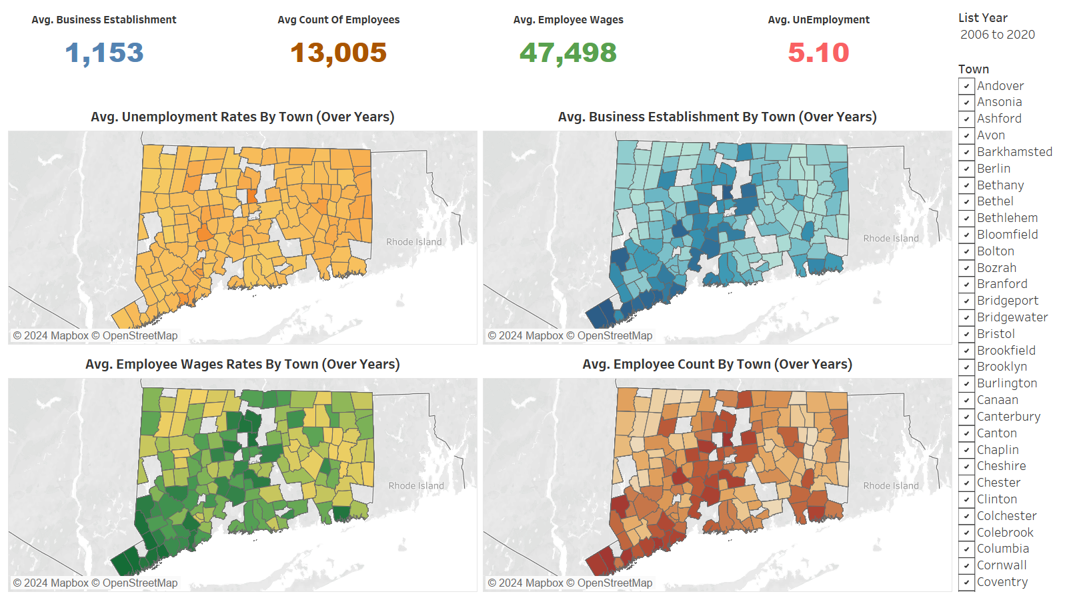

Slide 19
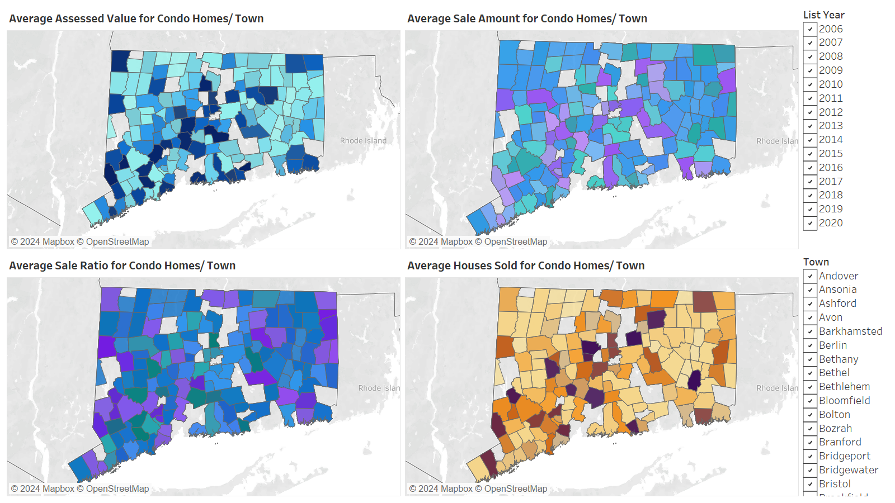

Slide 20
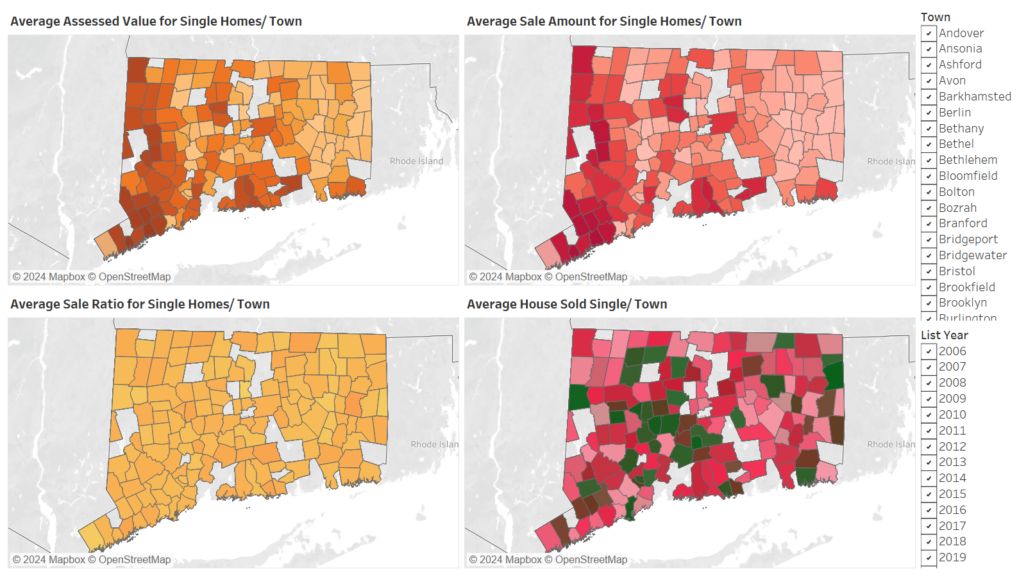

Slide 21
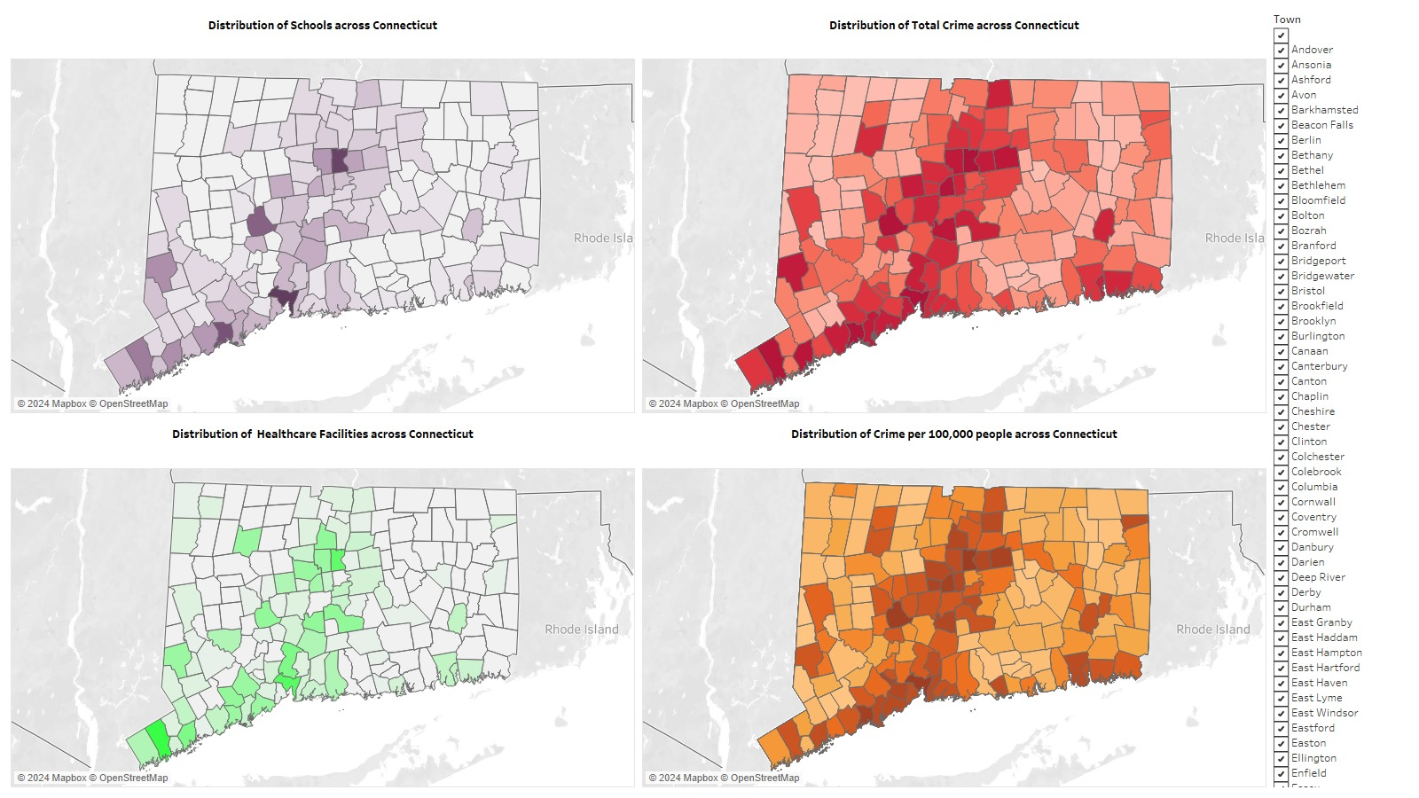

Slide 22
THE DIKW MODEL
Wisdom
Knowledge
Information
Data

Slide 23

ECONOMIC ANALYSIS

Slide 24
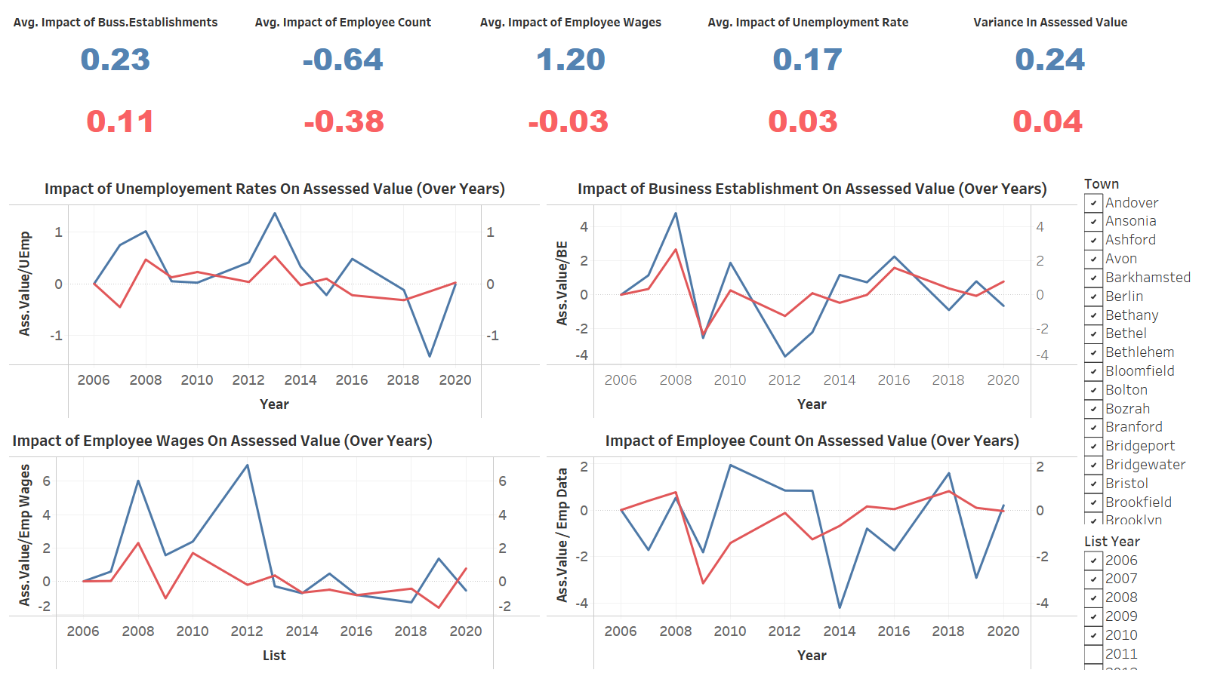

Slide 25
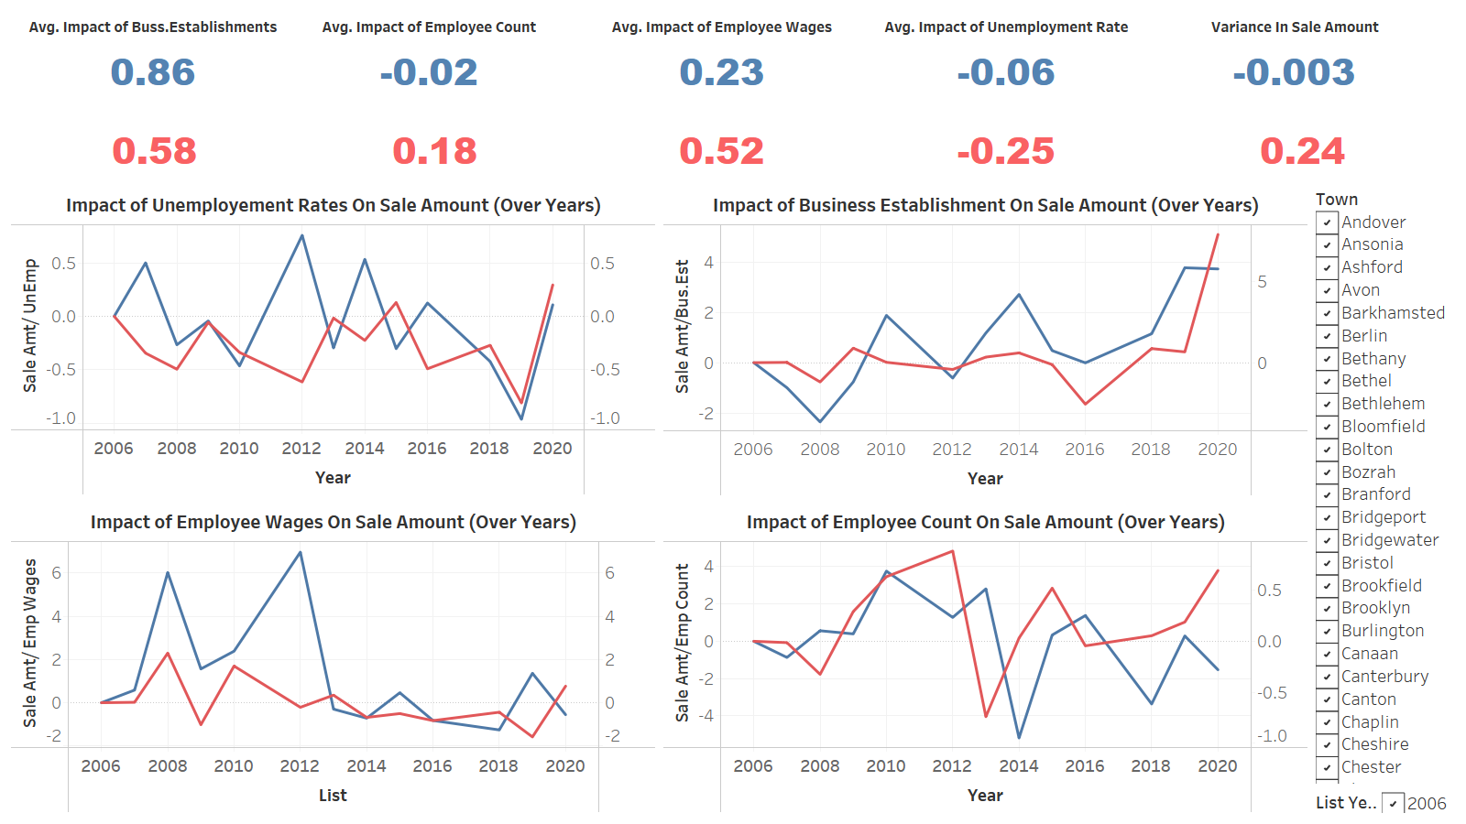

Slide 26
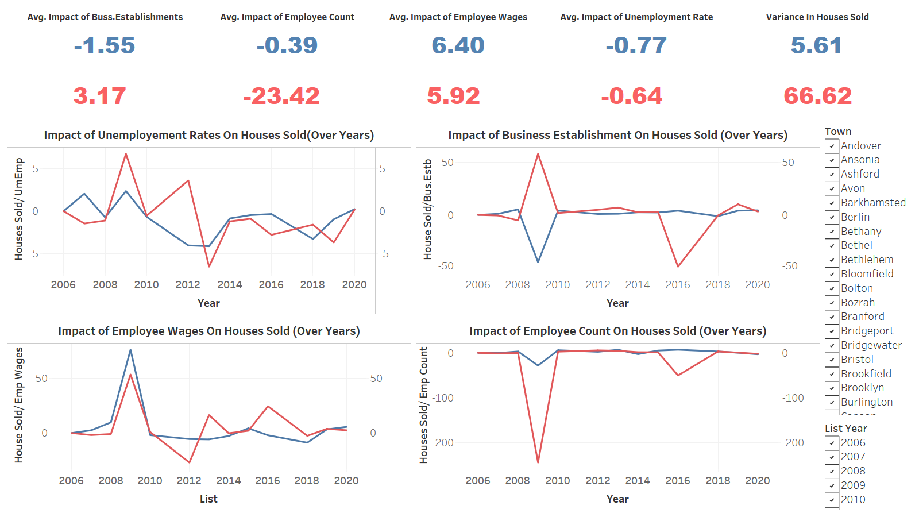

Slide 27

SOCIAL ANALYSIS

Slide 28
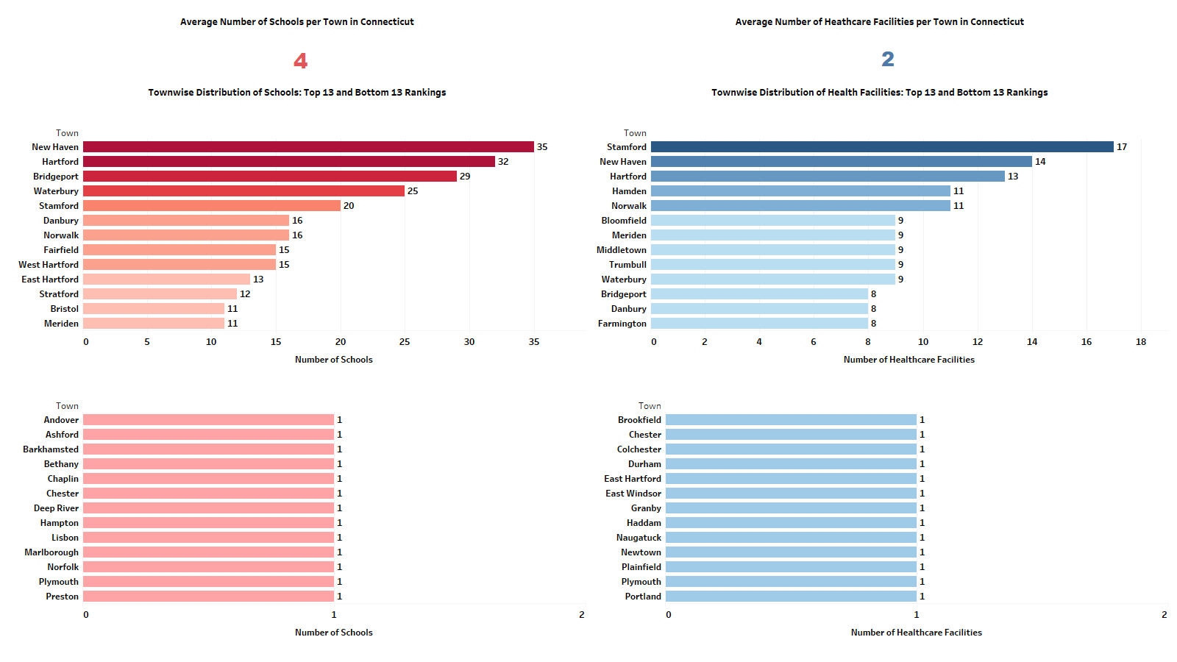

Slide 29
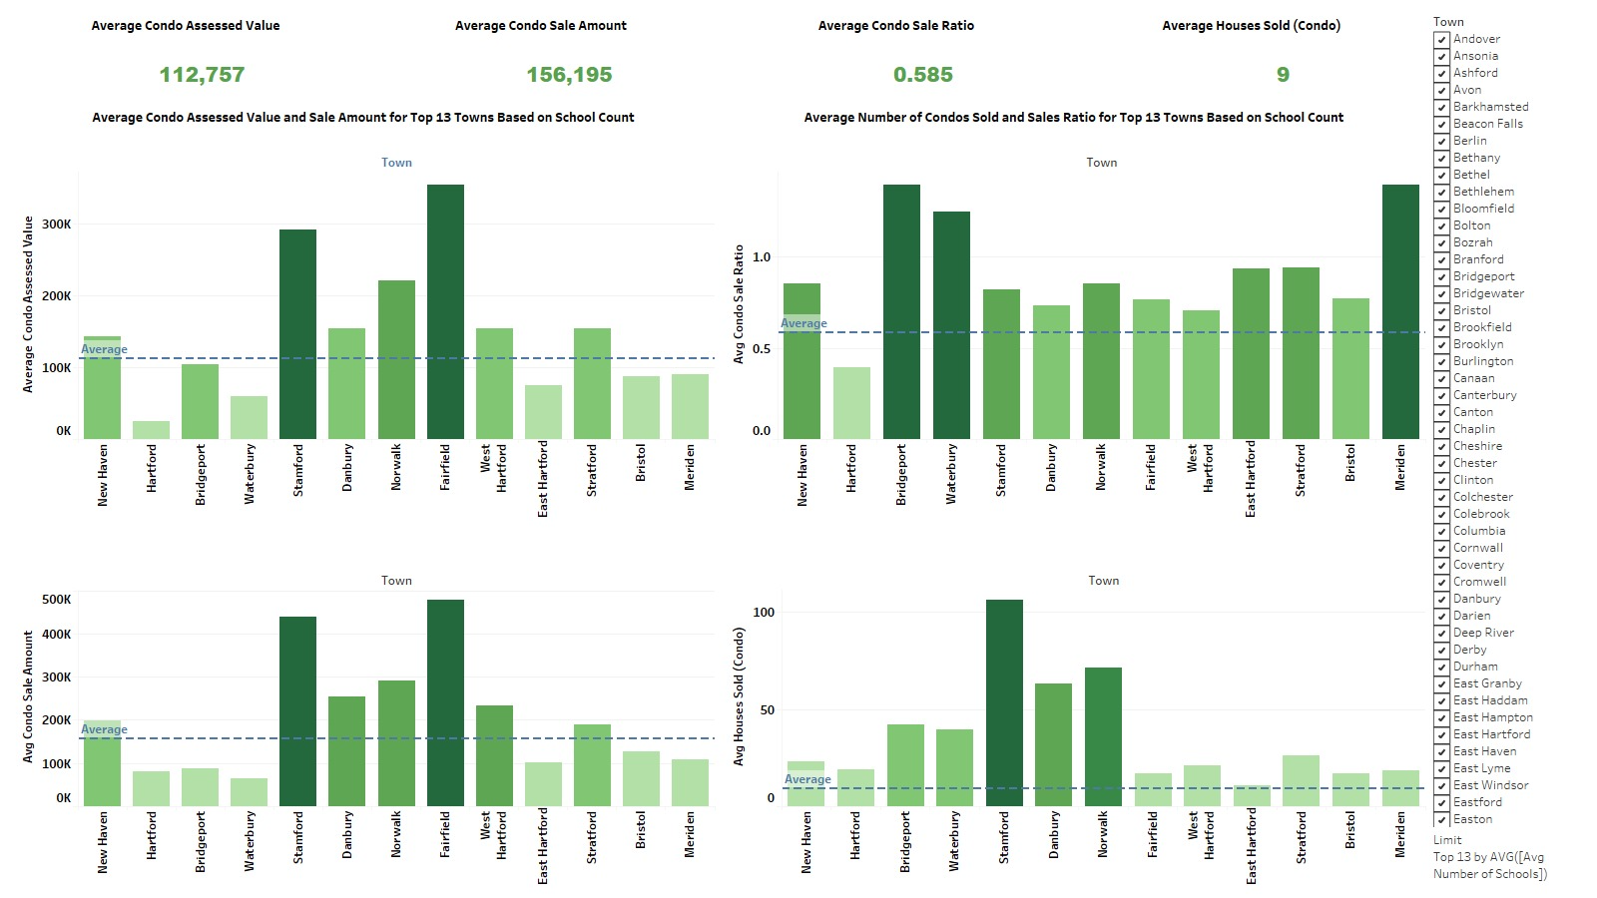

Slide 30
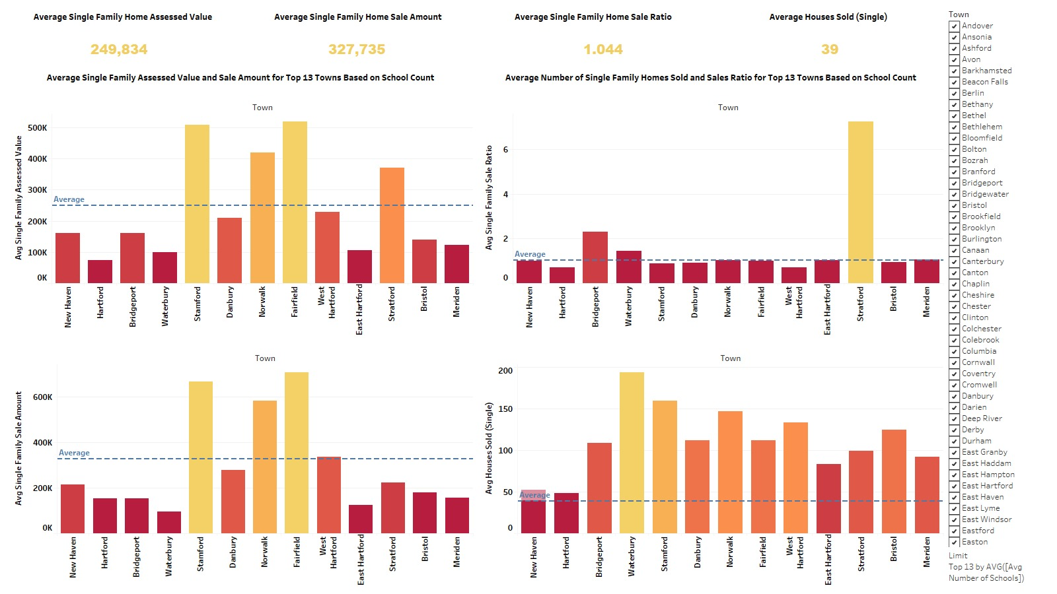

Slide 31
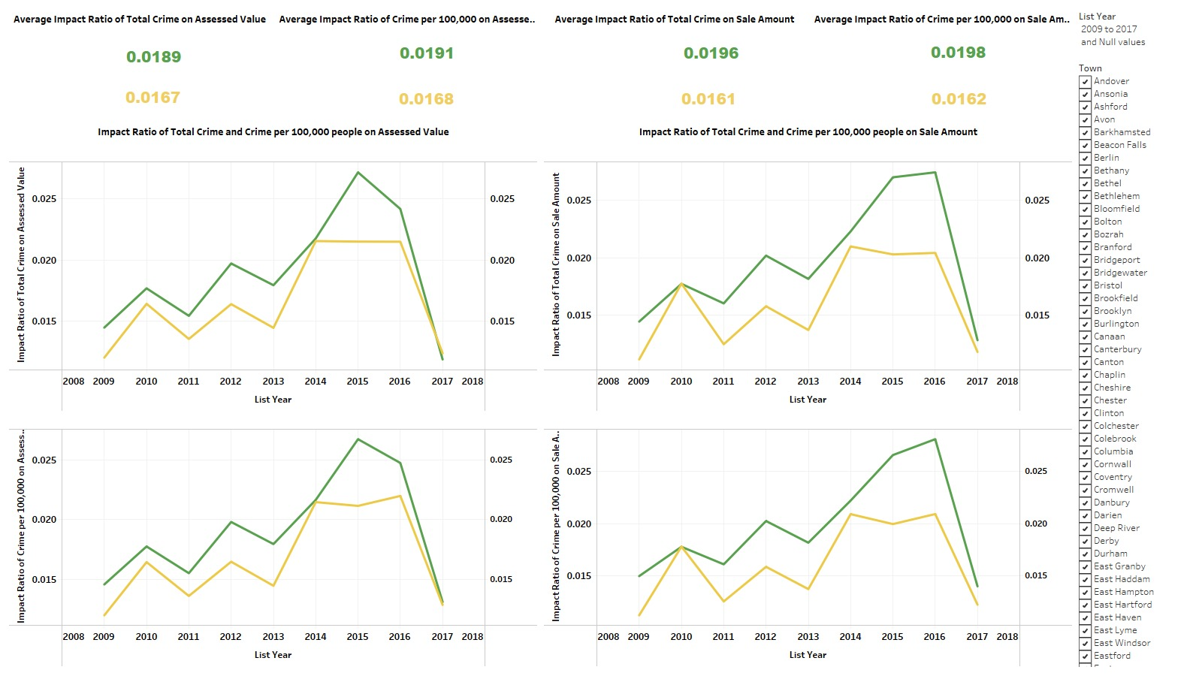

Slide 32
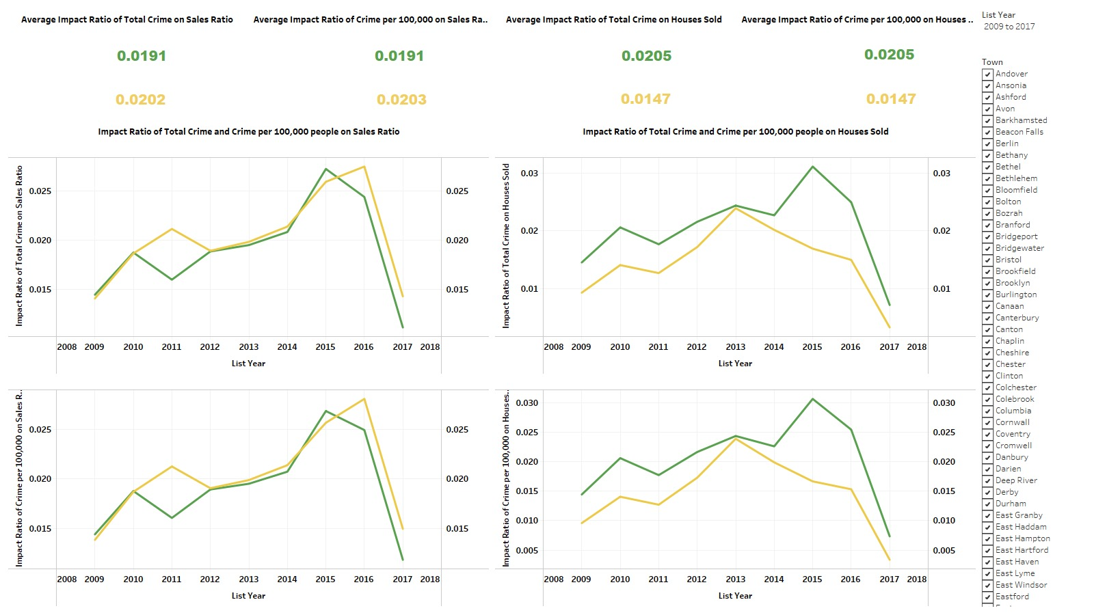

Slide 33
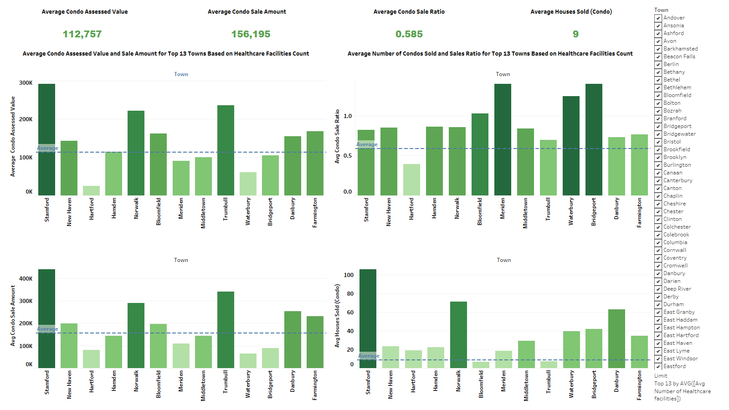

Slide 34
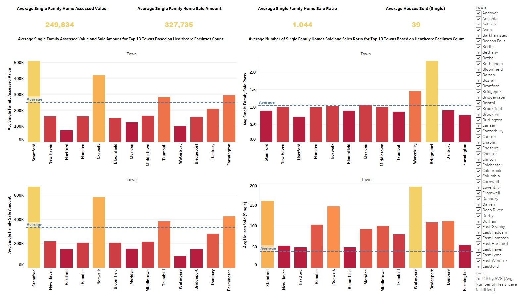

Slide 35

PREDICTIVE ANALYSIS

Slide 36
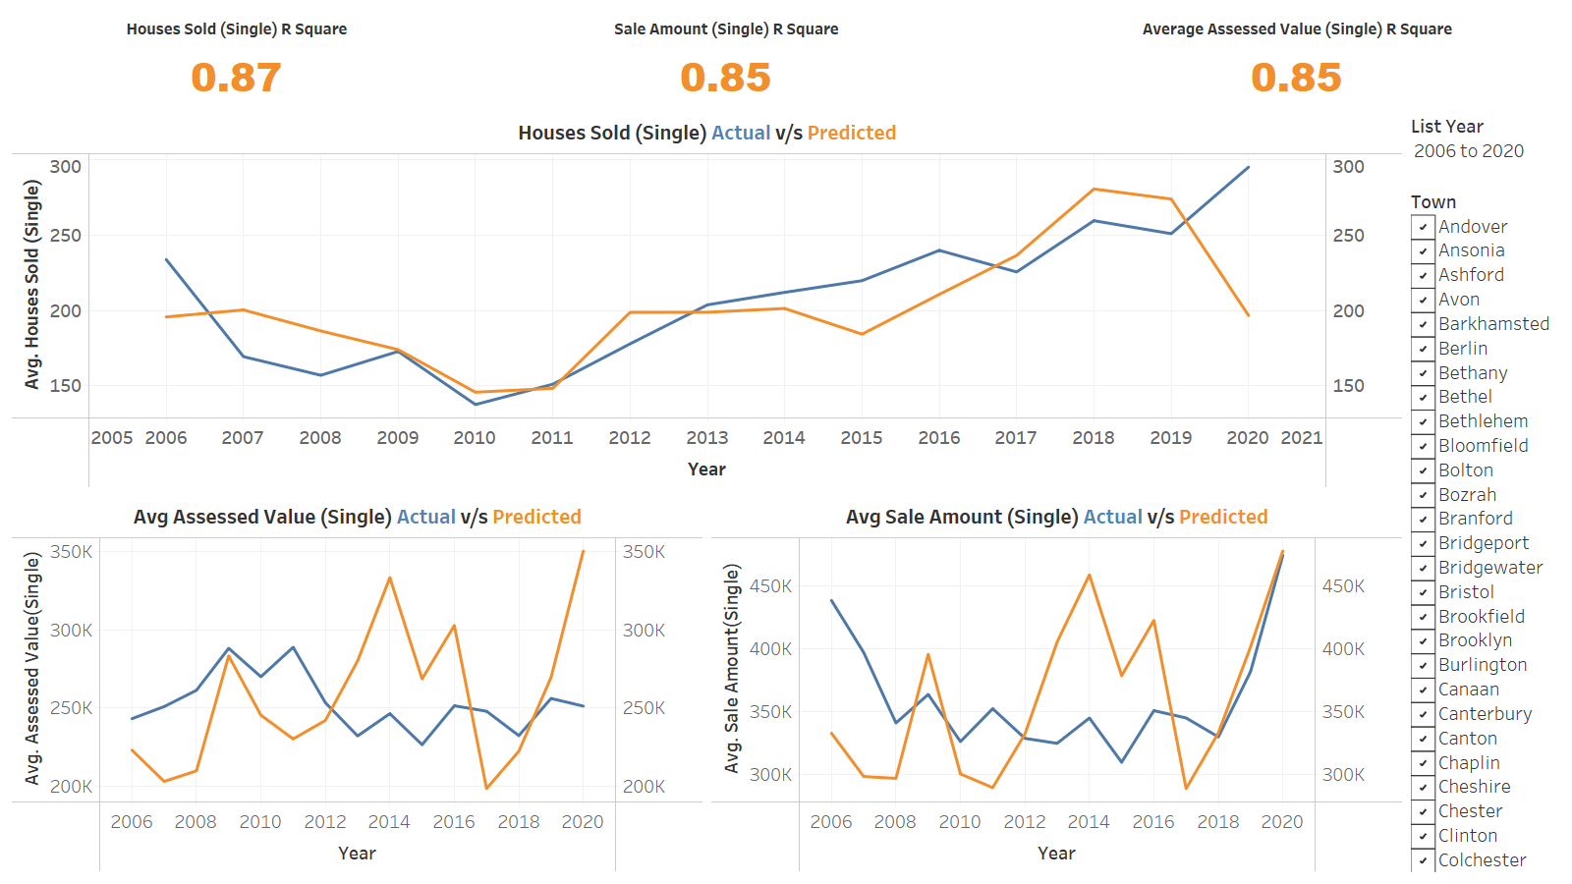

Slide 37
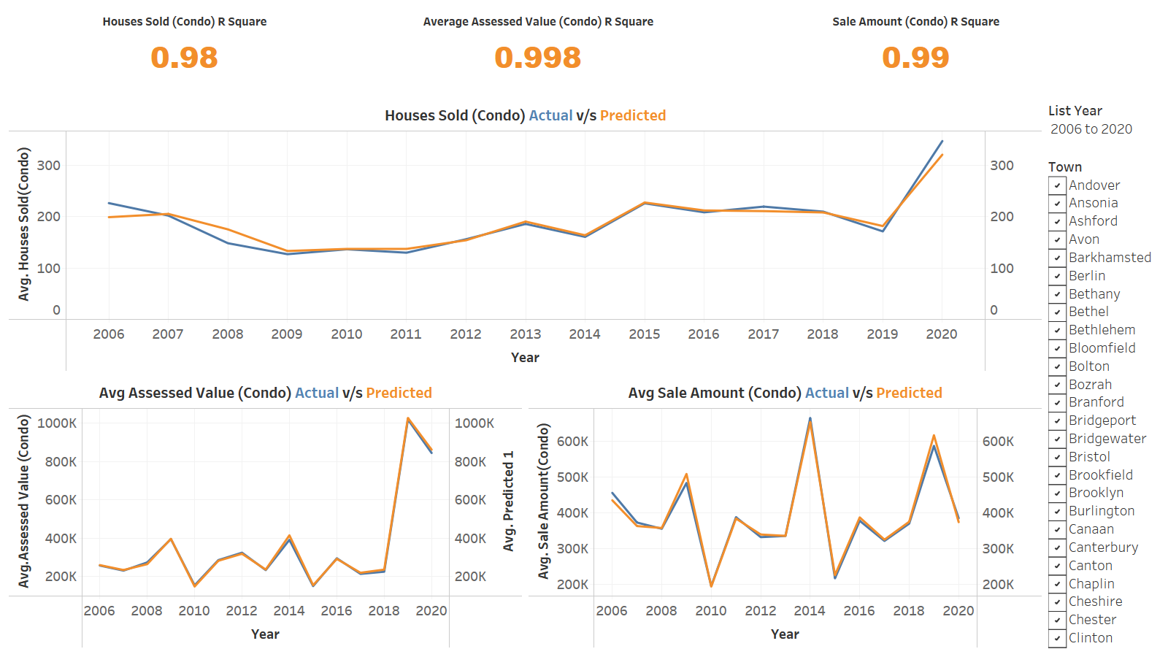

Slide 38
THE DIKW MODEL
Wisdom
Knowledge
Information
Data

Slide 39

Price Increases Condos $48,000 Single-Family $101,000
Consider Northwest Corner, Fairfield County, or Shoreline for potentially Higher Wages
Central Connecticut & South-East Connecticut are
places to look for with High Percentage of School (47%),
High Access to HealthCare (34%) and
Low Crime Rate (9%).
Investment in Single Family has been the trend (5-10%)
Sale/Assessed Ratio > 1
Eastern Connecticut is developing with 3% in Business Establishments & 5-10% increase in Wages
BENEFICIARY: COMMON PEOPLE

Slide 40

High Single-Family Demand 15%-20%
Target High-Growth Areas: Northwest Corner, Fairfield County, or Shoreline due to comparatively has Higher Wages than average by 5%-10%
Sale/Assessed Ratio is close to 1 indicating a potentially
strong market for development
Central Connecticut & South-East Connecticut
has an high affinity of sales in Single Family Homes,
The Property are listed and sold with an average
Timeframe of 6-8 months
Eastern Connecticut is developing with 3% in Business Establishments
& 5-10% increase in Wages
BENEFICIARY: REAL ESTATE DEVELOPERS

Slide 41


Workforce Development: Focus on West Connecticut, create 75K jobs to cut down the unemployment rate to 5%
Increase business formation by 8% (based on historical trends or regional benchmarks) and decrease unemployment to a target rate 5.8% below average (research current national unemployment rate).
Targeted Housing Assistance Programs: Based on the severity of the Affordability Gap (e.g., if it exceeds $12,000 or 30% of median income), consider implementing Targeted Housing Assistance programs.
Increased Revenue and Taxes from
Central Connecticut & South-East Connecticut
BENEFICIARY: Government Institution and Lawmakers

Slide 42
REFERENCES:
CTData. Real Estate Sales 2001-2020 GL. Retrieved from Real-Estate-Sales-2001-2020.
Connecticut Department of Labor. All of Connecticut Town Economic Indexes Recover In 2022. Retrieved from CTEI 2005-2022.
CTData. Connecticut Healthcare Facilities. Retrieved from Connecticut-Healthcare-Facilities.
CTData. Education Directory. Retrieved from Connecticut-School-Districts.
Connecticut Data Collabrative. UCR Crime Index. Retrieved from Police-Incidents-01/01/2005-to-05/18/2021.

Slide 43

THANK YOU!
Do you have any questions?

